Slide 1
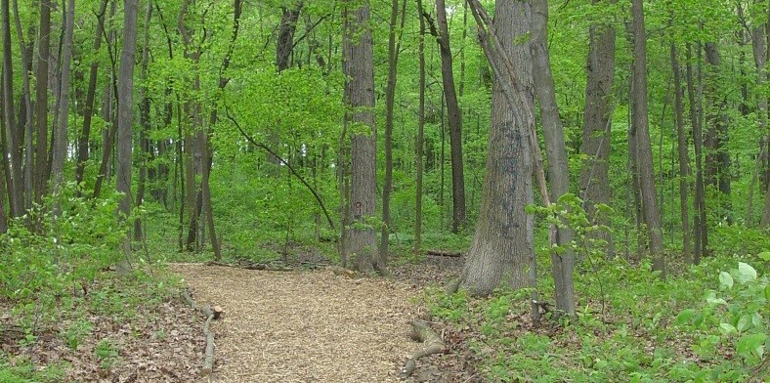

Story Map
Michigan Department of Natural Resources

